Slide 1


Competitive Machine learning approach for Retrieval of crop biophysical parameters from C-Band SAR data-
MTP Stage -I
-GUNJAN KUHIKAR
Guide: Prof Avik Bhattacharya

Slide 2
Probem statement:Farmers and agricultural service providers require reliable information on crop conditions and productivity throughout the cultivation period. The crop conditions and their productivity are directly related to the crop biophysical parameters such as Plant Area Index (PAI), Wet Biomass (WB), and Vegetation Water Content (VWC).
SAR data
Optical Data
Models for Retrieval
can easily penetrate
through clouds
only function in
the daytime
Machine Learning Models
Empirical/Physical Models
Stable and robust
.
Less expensive
.
Retrieval of Biophysical Parameters
Ill-posed nature
.
Expensive
.
Plant Area Index(PAI)
Biophysical parameters
Wet-Biomass(WB)
Vegetation Water Content(VWC)

Slide 3
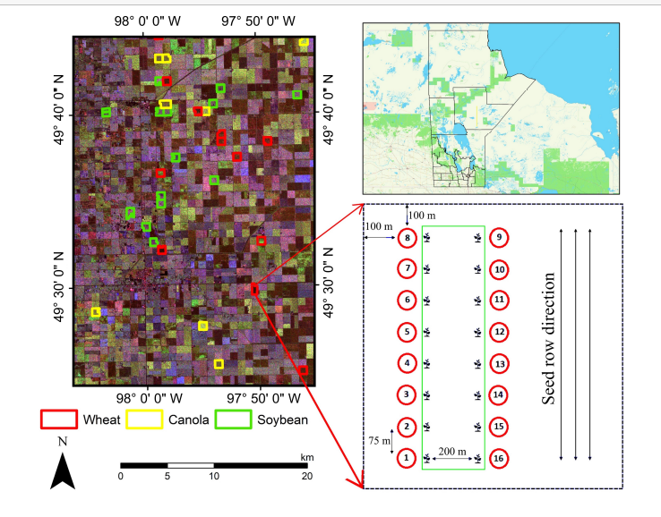
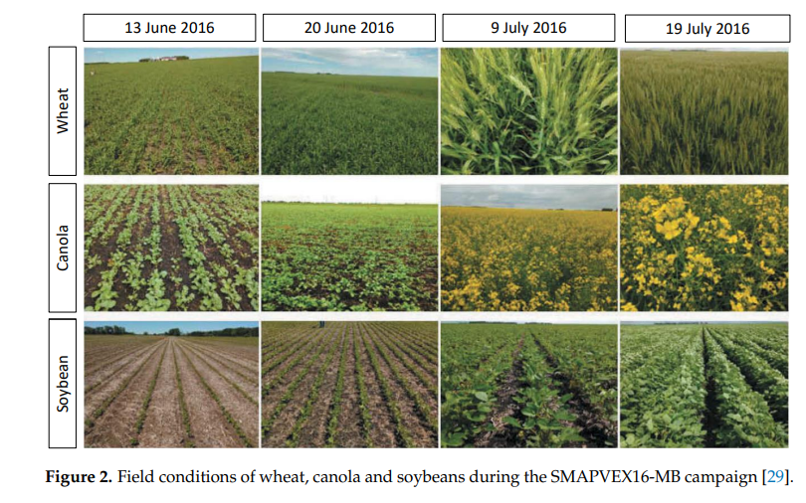
Study Area and Dataset
Figure 1. Pauli RGB image of RADARSAT-2 acquired on 17 July during the SMAPVEX16 campaign in Manitoba (Canada).
Fields sampled during the experiment are indicated, and the layout of the sampling design is indicated for one field.

Slide 4
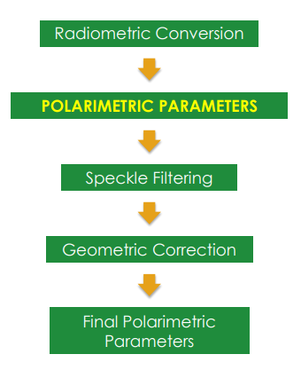
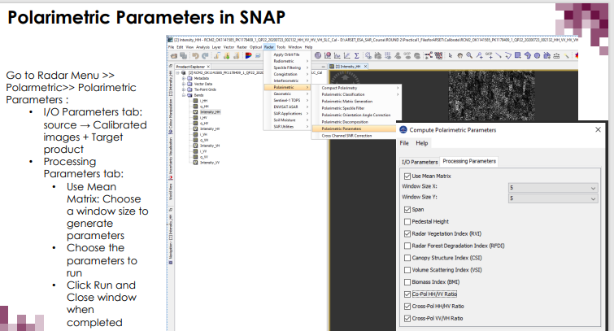
Generating Polarimetric Parameters in SNAP
Generating Polarimetric Parameters from SAR IMAGES in SNAP for Traning Purpose

Slide 5
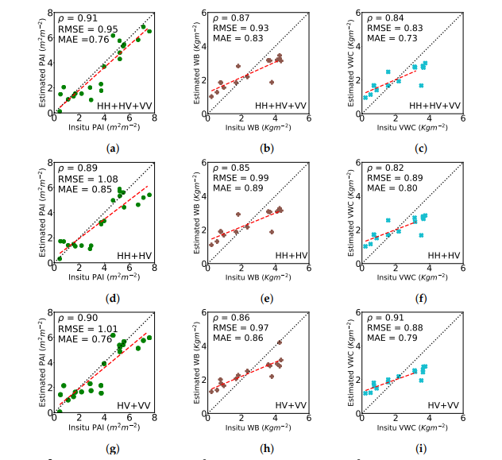
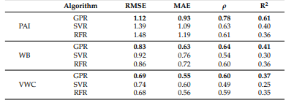
RESULTS FOR WHEAT CROP:
Comparison of the Three Algorithms with results
Scatter plot of the wheat crop using gaussian process regression with various polarizations

Slide 6
Advantages:
Cost effective
SAR cover large are at a same time
SAR data does not depend on seasonality and large area can be covered at the same time
Disadvantage:
Pre processing of SAR is difficult to interpret
Speckle reduces the resolution of images in SAR
finding the most relevant feature of a GPR model utilizing
an isotropic RBF kernel may not be enough.
Conclusion:
With increasing the accuracy this model can be used by the farmers to increase profit and yield of the crop

Slide 7
THANK YOU ☺

